Slide 1

RockBuster Stealth Data Analysis
Presenter: Alex Paredes

Slide 2

Goal: To develop a launch strategy for the new online video service
Key Questions:
Which movies contributed the most/least to revenue gain?
What was the average rental duration for all videos?
Which countries are Rockbuster customers based in?
Where are customers with a high lifetime value based?
Do sales figures vary between geographic regions?

Slide 3
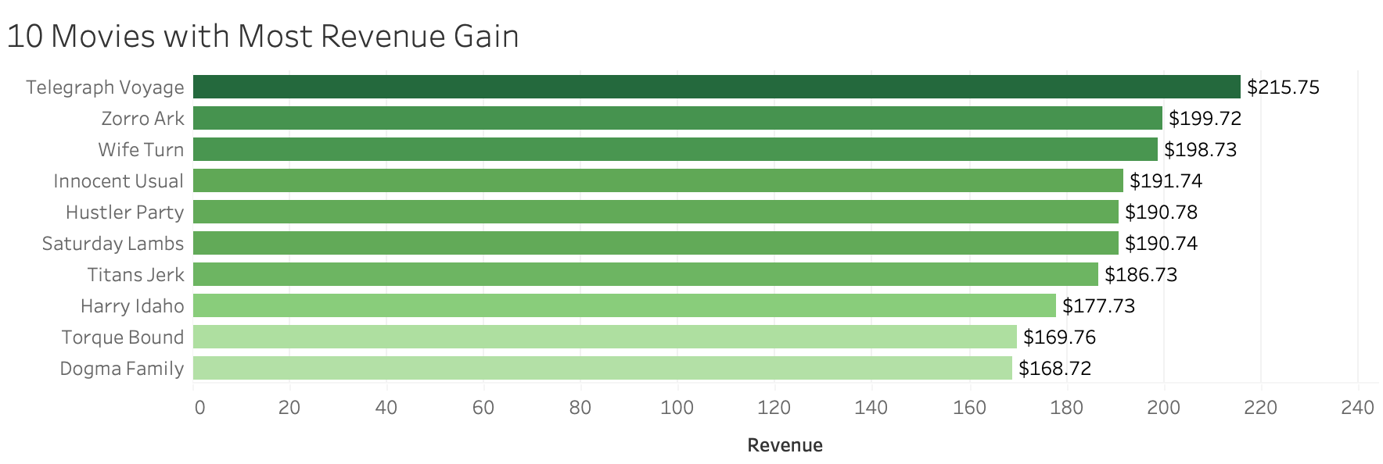
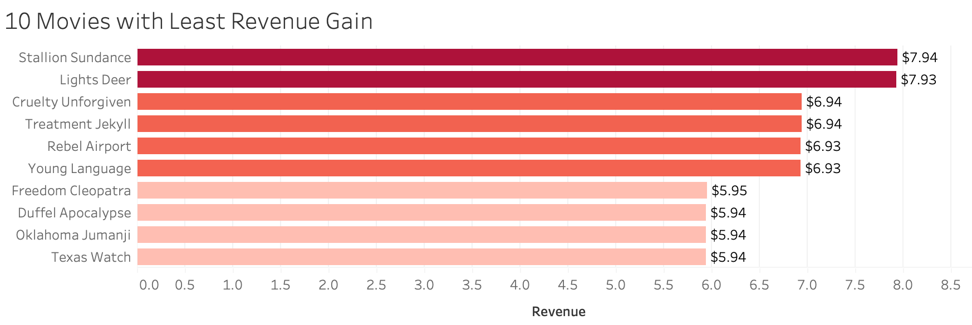
Which movies contributed the most/least to revenue gain?
Telegraph Voyage is the top-selling film with $215.75 in revenue
Duffel Apocalypse, Oklahoma Jumanji, and Texas Watch are the lowest revenue films with $5.94

Slide 4
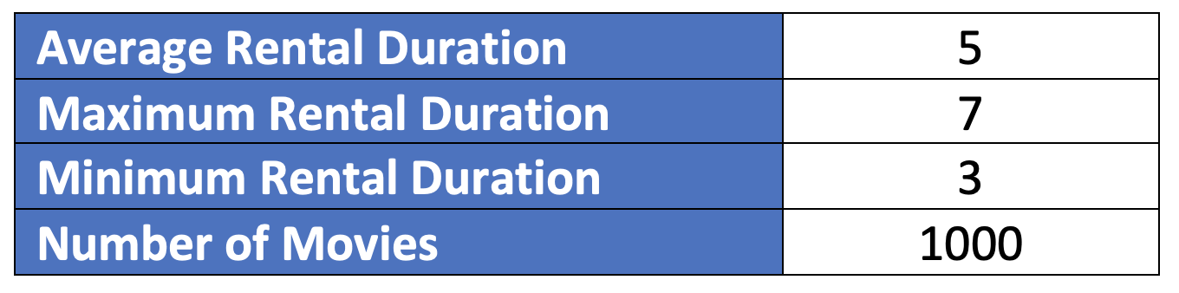
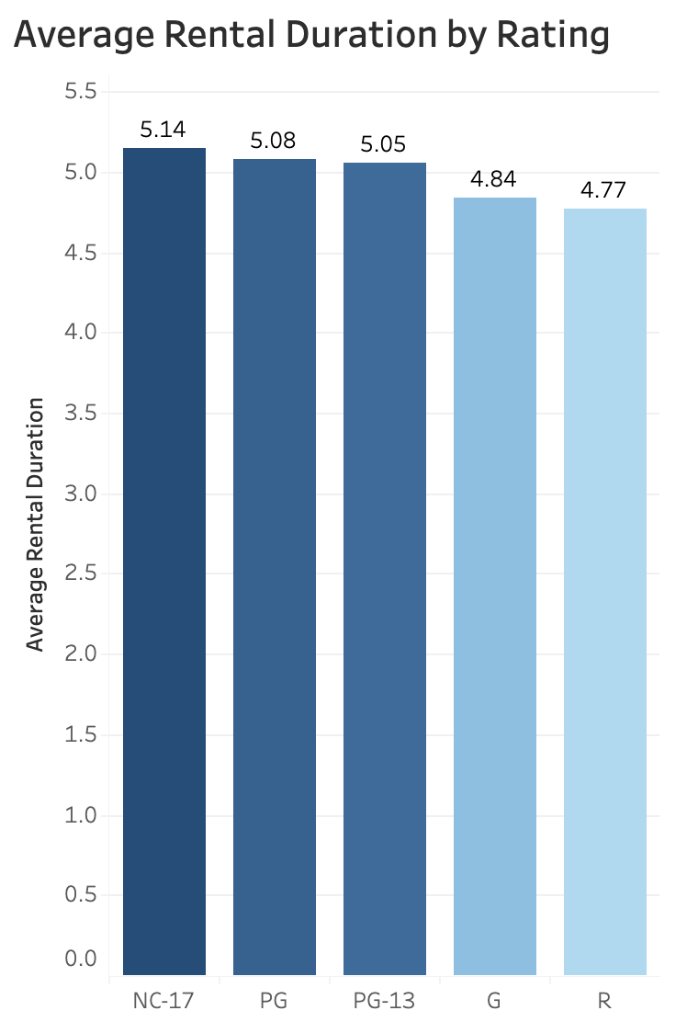
What was the average rental duration for all videos?
Average rental duration is 5 days
Maximum rental duration is 7 days
Minimum rental duration is 3 days
NC-17 is the top rating in rental duration with 5.14
R is the lowest rating in rental duration with 4.77

Slide 5
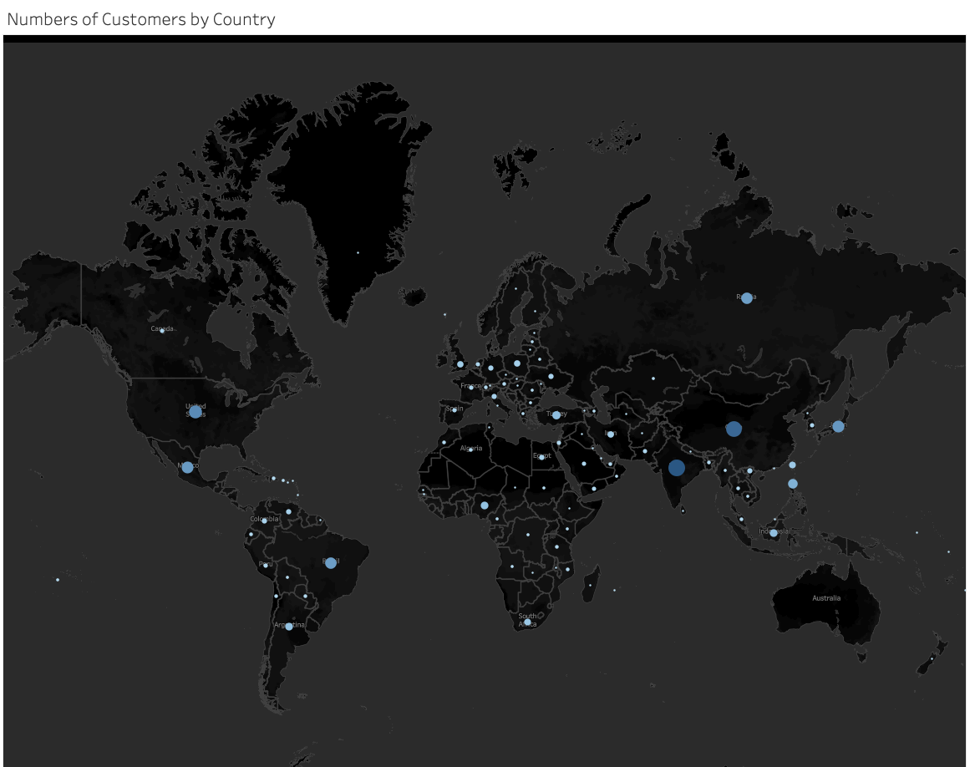
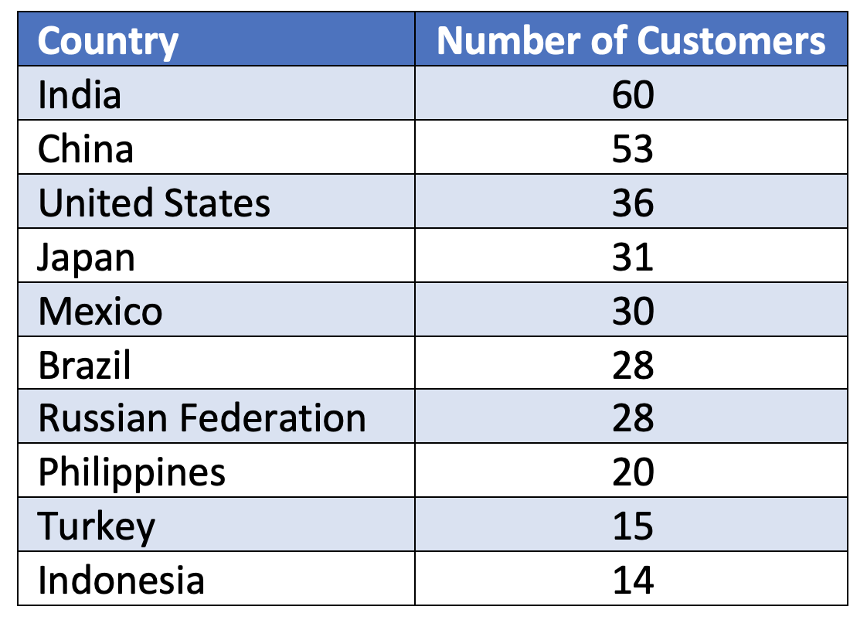
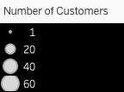
Which countries are Rockbuster customers based in?
Rockbuster customers are based in 108 countries
The top 5 countries with the highest number of customers: India, China, United States, Japan, and Mexico

Slide 6
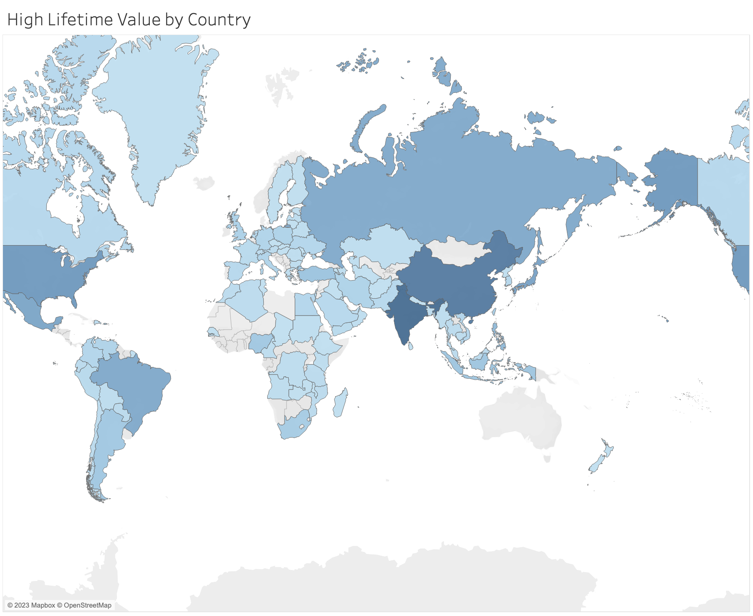
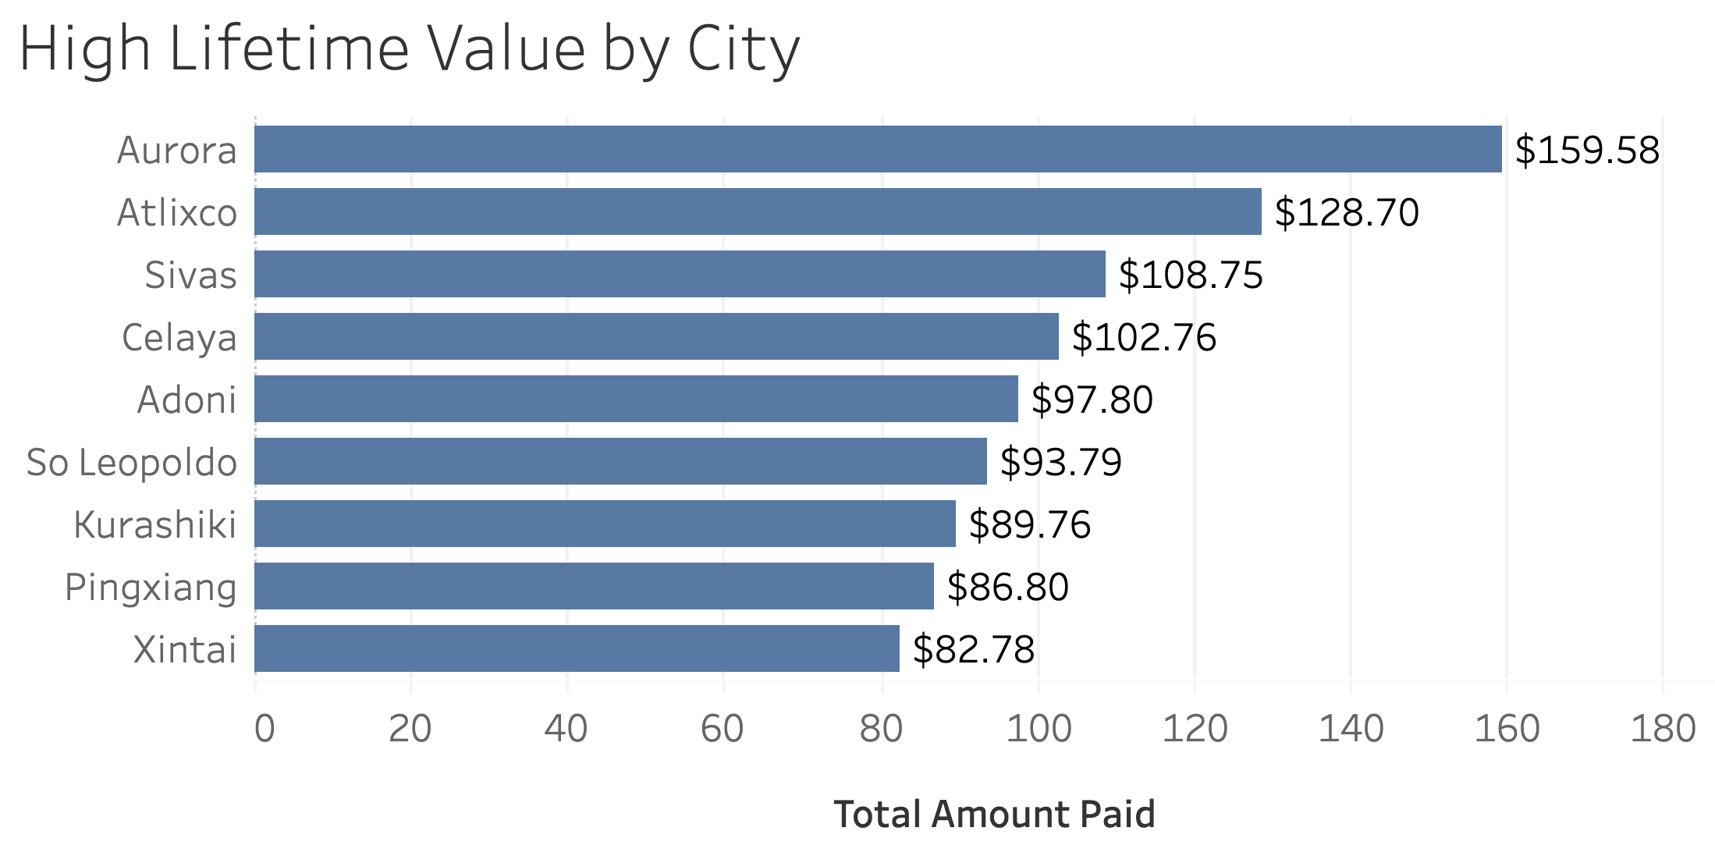
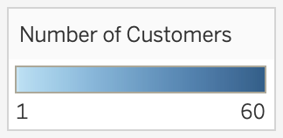
Where are customers with a high lifetime value based?
The top 5 cities of customers with high lifetime value: Aurora, Atlixco, Sivas, Celaya, and Adoni

Slide 7
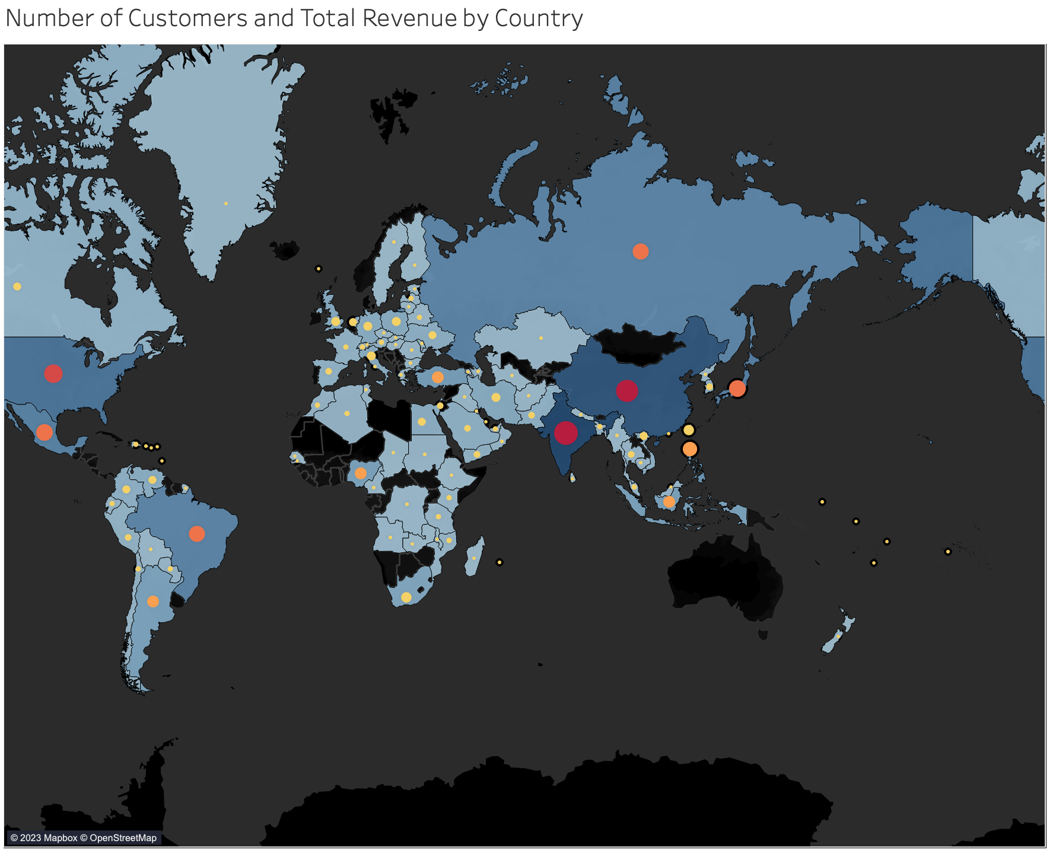
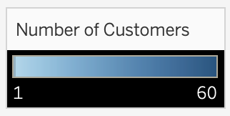
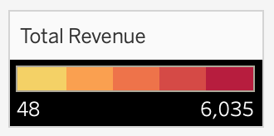
Do sales figures vary between geographic regions?
Yes, based on the shaded colors and circle sizes, countries with the highest number of customers generate the most revenue

Slide 8
Summary
Rockbuster has 1000 movies available with an average rental rate of $2.98 and an average rental duration of 5 days. NC-17 is the top rating in rental duration with 5.14. R is the lowest rating in rental duration with 4.77.
Rockbuster customers are based in 108 countries. The top 5 countries with the highest number of customers: India, China, United States, Japan, and Mexico. The majority of Rockbuster customers are based in Asia and North America.
Countries with the highest number of customers generate the most revenue. Since the maximum rental duration is 7 days, Rockbuster customers are more likely to rent movies for longer periods of time.

Slide 9
Recommendations
Rockbuster has negative film revenues that have not surpassed $10. It is recommended Rockbuster investigate the reason behind the low revenue for these movies.
The majority of Rockbuster customers are based in Asia and North America; it is recommended Rockbuster provide a marketing strategy to see what they can invest in for other regions and understand their preferences.
Countries with the highest number of customers should be rewarded for their loyalty with special promotions.

Slide 10
Questions?
Should you have any questions or concerns, please contact Alex via email at aparedes@rockbuster.com
Tableau Visualizations:
Tableau Public Profile

